Slide 1
Recomender system for groceries contractor
Applied Data Science Capstone

Slide 2
Business Problem (Description)
There is a contractor in one of the boroughs of Toronto (Mississauga), that provides places such as: restaurants, bakeries and coffe shops.
The contractor wants to build a warehouse for the groceries it buys from villagers and farmers inside the borough, so that they will support more customers and also bring better quality of service.
If the warehouse is close to those restaurants, then the vegetables and other groceries would be delivered to the restaurant in the right time and there would be no delay so the restaurant cooks can start their job from the morning, increasing the quality of service. That way, the contractor business will be more profitable.
The contractor should build this warehouse where it is closest to its customers in order to minimize the cost of transpotation. To find the right place is the mission.The system need to provide the best recomendation to the contractor, suggesting the best neighborhood to buid the warehouse.
The system need to provide the best recomendation to the contractor, suggesting the best neighborhood to buid the warehouse.

Slide 3
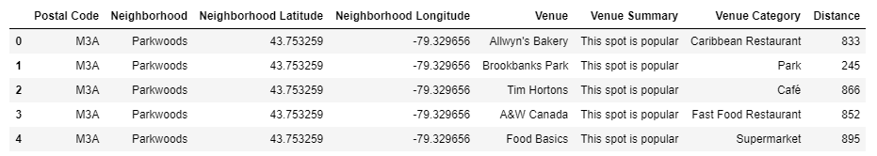
Data Description
We need the informations below:
Geo-locational information and the neighborhoods in Mississauga, Toronto (latitude and longitude) and the postal codes. We need data about different venues in different neighborhood from Mississauga. In order to get this information, we can use Foursquare API. A request from Foursquare will provide us with the following information:
We are looking for advanced information, such as venue's category and if that venue is popular in its category or the average price of the services of this venue.

Slide 4
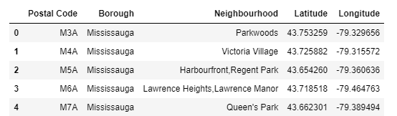
Identifying Neighborhoods inside "Mississauga"
We will use Postal Codes of different regions inside Mississauga to find the list of neighborhoods. We will essentially obtain our information from "https://en.wikipedia.org/wiki/List_of_postal_codes_of_Canada:_M" and then process the table inside this site.

Slide 5
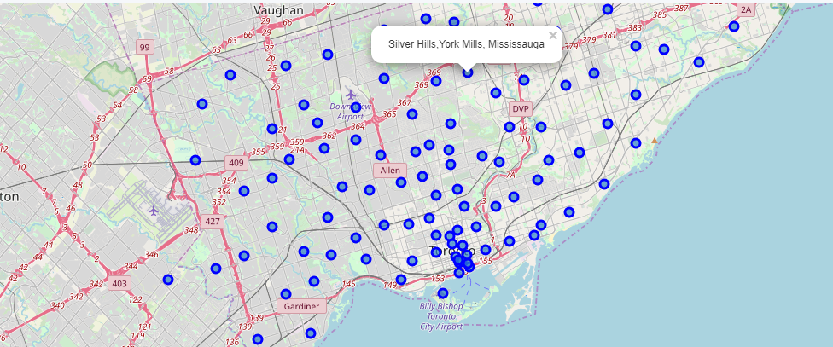
Connecting to Foursquare and retrieving locational data for each venue in the neighborhood
After finding the list of neighborhoods, we then connect to the Foursquare API to gather information about venues inside each and every neighborhood. For each neighborhood, we have chosen the radius to be 1000 meter. It means that we have asked Foursquare to find venues that are at most 1000 meter far from the center of the neighborhood. Map with its Postal Code’s regions:

Slide 6
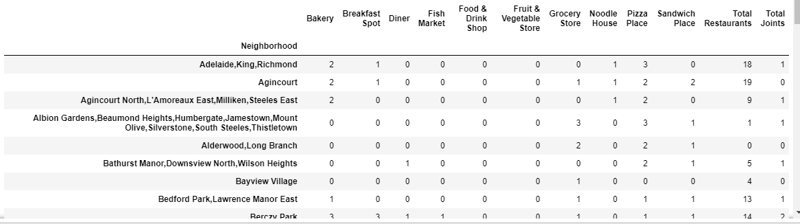
Processing the Retrieved Data and Creating a DataFrame for all the venues inside the Mississauga
When the data is completely gathered, we will perform processing on that raw data to find our features for each venue. Our main feature is the category of that venue. After this stage, the column "Venue's Category" wil be one-hot encoded and different venues will have different feature-columns. Now, the dataset is fully ready to be used for machine learning (and statistical analysis) purposes.

Slide 7
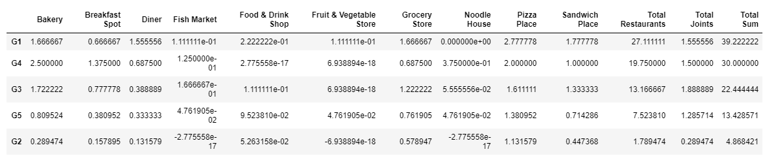
Applying one of Machine Learning Techniques (K-Means Clustering)
Here we cluster neighborhoods via K-means clustering method. We think that 5 clusters is enough and can cover the complexity of our problem. After clustering we will update our dataset and create a column representing the group for each neighborhood.

Slide 8
DECISION MAKING - Reporting Results
Now, we focus on the centers of clusters and compare them for their "Total Restaurants" and their "Total Joints". The group which its center has the highest "Total Sum" will be our best recommendation to the contractor.
Results:
Based on this analysis, the best recommended neighborhood will be:
Group 1
Thank you ;)
By Fabiano Beraldi

